Slide 1
INCLUDES WORKED EXAMPLES, DERIVATIONS, EXERCISES, AND DIAGRAMS
Work, Energy, and Power
Based directly on the NCERT Class 11 Physics Textbook

Slide 2


Slide 3







1.1 Introduction: Key Definitions
Work
Energy
Power
Work is defined as the product of the component of force in the direction of displacement and the magnitude of displacement. In physics, standing still creates no work.
Energy is strictly defined as the capacity of a body to do work. It is deeply connected to work, sharing the exact same units and dimensional formula.
Power is the time rate at which work is done or energy is transferred. It relates to how quickly an activity (work) is performed.

Slide 4
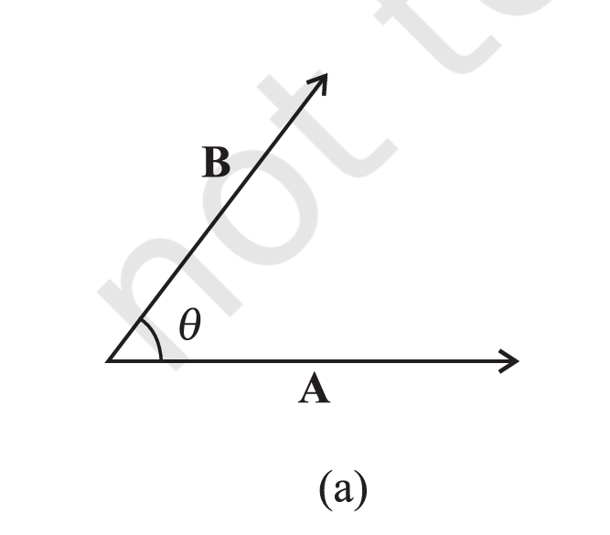
1.2 The Scalar (Dot) Product
Mathematical Definition
The scalar product or dot product of any two vectors A and B, denoted as A·B, is defined as:
Where θ is the angle between the two vectors. The dot product yields a scalar quantity (magnitude only, no direction).

Slide 5
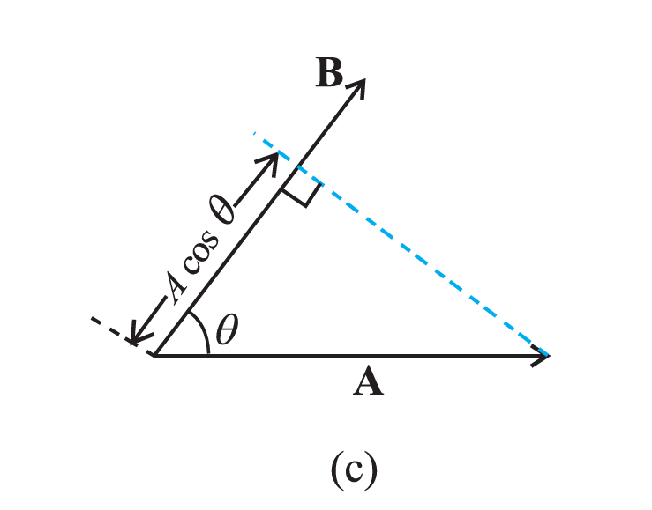
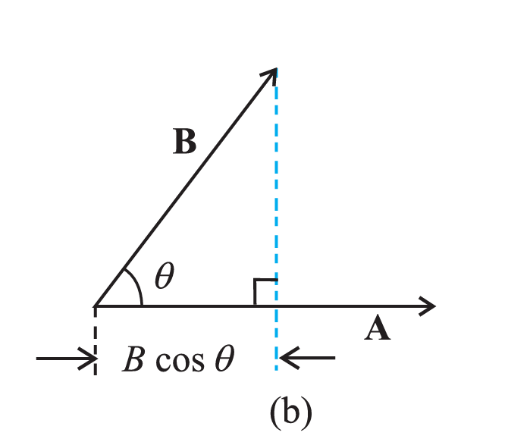
Geometric Meaning of Dot Product
The geometric interpretation of the dot product relies on projections:
The figures illustrate projecting one vector strictly onto the axis of the other to find the parallel contribution.
A·B = (Magnitude of A) × (Component of B along A)
Alternatively, A·B = (Magnitude of B) × (Component of A along B)

Slide 6
Properties of the Scalar Product
Property | Mathematical Formula | Explanation
Commutative Law | A · B = B · A | Order doesn't matter
Distributive Law | A · (B + C) = A·B + A·C | Distributes over addition
Scalar Multiplication | A · (λB) = λ(A · B) | Scalar can be factored out
Unit Vectors | i·i = j·j = k·k = 1 i·j = j·k = k·i = 0 | Parallel = 1, Orthogonal = 0

Slide 7



Example 5.1: Scalar Product Setup
Problem Statement
Required Formulas
Given the force and displacement vectors below, find the angle between F and d, and the projection of F on d.
Component dot product:
A·B = AxBx + AyBy + AzBz
Magnitude: A = √(Ax² + Ay² + Az²)
Angle: cos θ = (A·B) / AB

Slide 8










Example 5.1: Calculation
Dot Product & Magnitudes
Angle & Projection
STEP 1: F · D
STEP 3: CALCULATE ANGLE Θ
STEP 4: PROJECTION OF F ON D
STEP 2: MAGNITUDES

Slide 9
Work-Energy Theorem
Complete Mathematical Derivation for Constant and Variable Forces

Slide 10
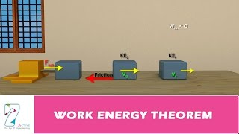

Slide 11




The Theorem Statement
The Work-Energy Theorem states that the net work done on an object by all forces is equal to its change in Kinetic Energy.
If Work is Positive (+ve)
If Work is Negative (-ve)
Kinetic Energy Increases
Kinetic Energy Decreases

Slide 12

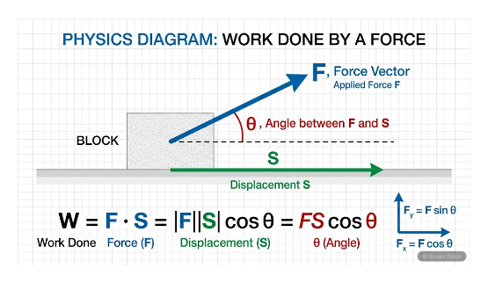





Derivation for a Constant Force (Part 1)
We begin with the third equation of motion (kinematics) for an object undergoing constant acceleration:
Equation of Motion:
Multiply both sides of the equation by :

Slide 13



Derivation for a Constant Force (Part 2)
01Expand the left side and simplify the right side of our equation:
02From Newton's Second Law, we know that Force F = ma.
We substitute this into the right side:
03Recognizing the definitions of Kinetic Energy and Work:

Slide 14



Derivation for a Variable Force (Part 1)
01When force is not constant, we use calculus. Start with the formula for Kinetic Energy:
02Differentiate both sides with respect to time t:
03Apply the chain rule to the right side to differentiate v² with respect to t:

Slide 15



Derivation for a Variable Force (Part 2)
01Simplify the expression by canceling the 2s and rearranging the terms:
02We know that acceleration a = dv/dt and Force F = ma. Substitute these into the equation:
03Next, substitute velocity v with the rate of change of position, v = dx/dt:

Slide 16

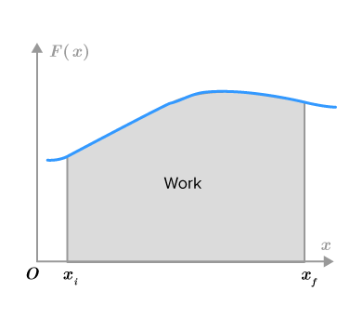





Derivation for a Variable Force (Part 3)
By canceling from both sides, we relate the infinitesimal change in Kinetic Energy to the infinitesimal Work done:
Now, we integrate both sides over the path of the object, from the initial state to the final state:
Initial state: Position , Kinetic Energy
Final state: Position , Kinetic Energy

Slide 17




Derivation for a Variable Force (Part 4)
Evaluate the integral on the left side:
The right side of the equation is the standard definition of Work ( ) done by a variable force. We substitute :
Final Conclusion:

Slide 18




Example 5.2: Raindrop (Part 1)
Problem Statement
Work by Gravity
A raindrop of mass m = 1.00 g falls from height h = 1.00 km. It hits the ground with speed v = 50.0 m/s.
EQUATION
First, calculate the work done by the gravitational force.
SUBSTITUTION

Slide 19


Slide 20


Example 5.2: Raindrop (Part 2)
Resistive Force
Applying W-E Theorem
Calculate the work done by the resistive force using the Work-Energy Theorem.
CHANGE IN KE
The total work is the sum of gravitational work and resistive work.
RESISTIVE WORK

Slide 21


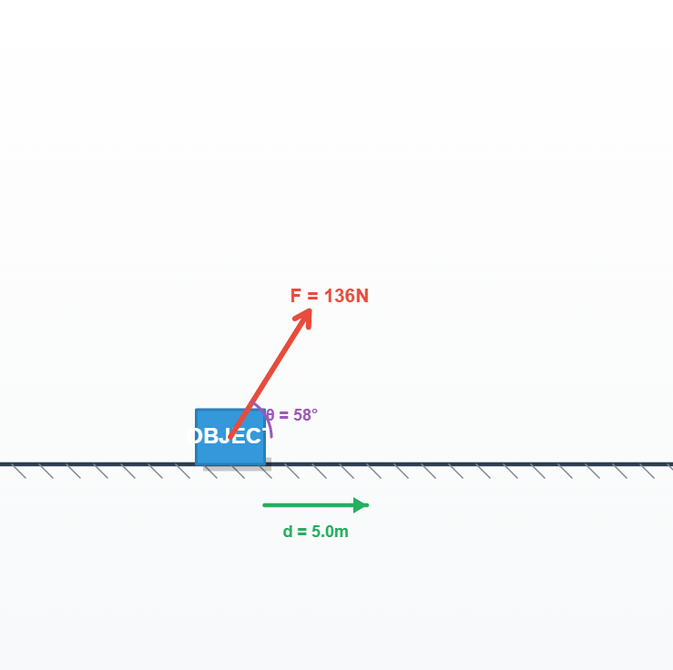
2.2 Detailed Work Definition
Work done by a constant force is defined as the dot product of the force vector and the displacement vector.
Accounts only for the component of force strictly along the displacement line.
If multiple forces act on a body, total work is the sum of works done by each force.

Slide 22



Cases of Zero Work
Zero Displacement
Zero Force
Perpendicular Force
Holding a 150 kg mass stationary on your shoulder. Despite biological energy spent, displacement is zero, so Work = 0.
A block moving at constant velocity on a smooth horizontal table experiences zero net force, hence no work is done on it.
If θ = 90°, cos(90°) = 0. The moon orbiting Earth experiences a gravitational force exactly 90 degrees to motion.

Slide 23
Sign of Work
Condition (Angle θ) | Sign of Work | Example
0° ≤ θ < 90° | Positive (+) | Pushing a box forward.
θ = 90° | Zero (0) | Satellite in circular orbit.
90° < θ ≤ 180° | Negative (-) | Friction opposing motion.

Slide 24
Units of Work (Table 5.1)
Unit | Value in Joules (J)
1 erg | 10⁻⁷ J
1 electron volt (eV) | 1.6 × 10⁻¹⁹ J
1 calorie (cal) | 4.186 J
1 kilowatt hour (kWh) | 3.6 × 10⁶ J

Slide 25


Example 5.3: Cyclist Skidding
Problem Setup
Work by Road on Cycle
A cyclist skids to a stop in 10 m. The force on the cycle due to the road is 200 N, opposing motion.
CALCULATION
Work by cycle on road is ZERO because road displacement = 0.

Slide 26
Kinetic Energy
Definition, Properties, and Relation to Linear Momentum

Slide 27
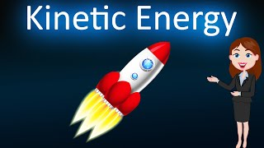




What is Kinetic Energy?
Definition:
Kinetic Energy is the energy possessed by the motion of a body.
Standard Formula:
Vector Representation (Dot Product):

Slide 28










Key Characteristics
Sign
SI Unit
Dimension
Kinetic Energy with respect to any frame of reference must be positive.
The standard international unit for Kinetic Energy is the Joule.
The dimensional formula represents mass, length, and time dependencies.
(Because mass is positive and velocity squared is always positive).

Slide 29





Relation Between Kinetic Energy & Linear Momentum
Let's derive the relationship step-by-step, starting with the base formulas.
Kinetic Energy ( ):
Linear Momentum ( ):
To link them, multiply the numerator and denominator of the Kinetic Energy equation by mass ( ):

Slide 30






Finalizing the Relationship
Since Momentum , we can square both sides to see that .
Substitute into the numerator:
Now, solve for Linear Momentum ( ):
Multiply both sides by 2m:

Slide 31
Table 5.2: Typical Kinetic Energies
Object | Mass (kg) | Speed (m/s) | K (J)
Car | 2000 | 25 | 6.3 × 10⁵
Running athlete | 70 | 10 | 3.5 × 10³
Bullet | 5 × 10⁻² | 200 | 10³
Raindrop (terminal) | 3.5 × 10⁻⁵ | 9 | 1.4 × 10⁻³

Slide 32


Example 5.4: Bullet and Plywood
Problem Setup
Step-by-Step Calculation
A bullet of mass 50.0 g with speed 200 m/s hits plywood and emerges with exactly 10% of its initial KE. Find emergent speed.
INITIAL KE
FINAL KE & SPEED

Slide 33
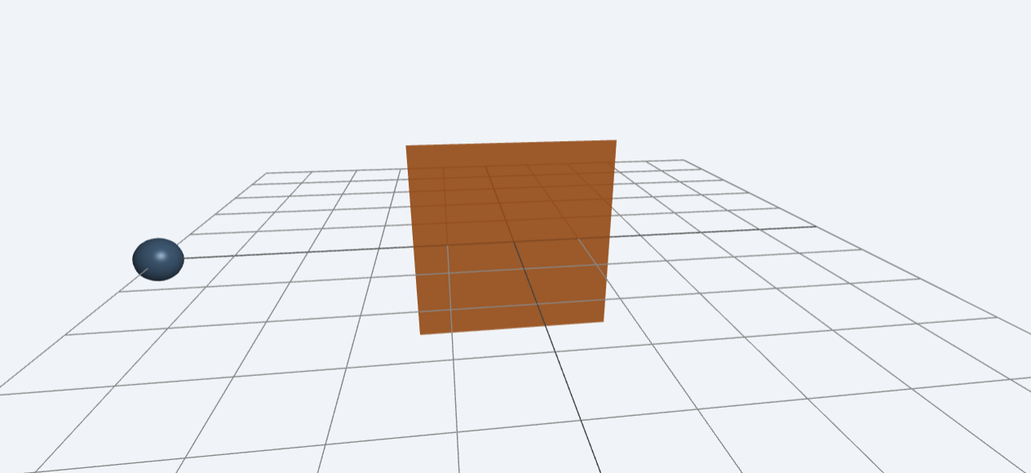

Slide 34
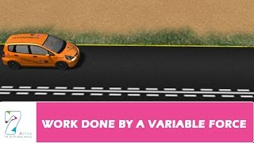
3.1 Work Done by Variable Force
For a small displacement Δx, the varying force F(x) is approximately constant.
Total Work is the sum of these segments, leading to an integral as Δx approaches zero.

Slide 35

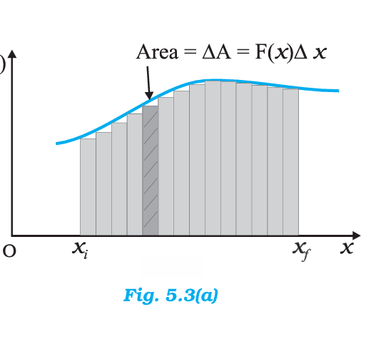


Graphical Interpretation
The total work done by a variable force over a displacement is represented graphically.
The area precisely under the Force-Displacement curve represents the work done.

Slide 36
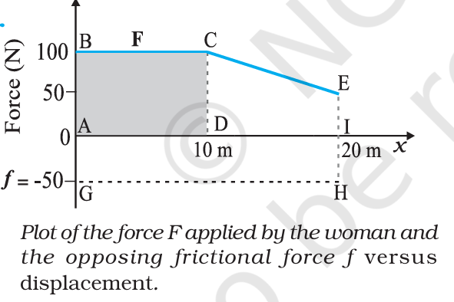
Example 5.5: Variable Force Setup
Problem Statement
Woman pushes a trunk.
Force = 100 N for first 10 m.
Force reduces linearly to 50 N over next 10 m.
Friction = 50 N (opposing).

Slide 37



Example 5.5: Calculation
Work by Woman
Work by Friction
Calculate areas: Rectangle + Trapezoid.
Calculate area below x-axis.

Slide 38


Example 5.6: Block on Rough Patch
Problem Setup
Calculus Application
1 kg block at 2 m/s enters rough patch. Fr = -k/x for 0.1 < x < 2.01 m, k = 0.5 J.
We integrate 1/x, which yields the natural logarithm (ln).

Slide 39

The Concept of Potential Energy
Stored Energy, Gravity, and Conservative Forces

Slide 40
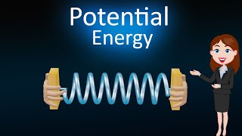

What is Potential Energy?
The word potential suggests a possibility or capacity for action.
Potential energy is essentially 'stored' energy.
It is the energy possessed by a body by virtue of its position or configuration.
When a body is left to itself, this stored energy is released and manifests as kinetic energy (motion).
Dimensions:
SI Unit: Joule (J) — the same as kinetic energy and work.

Slide 41





Manifestations of Stored Energy
The Stretched Bow
Earth's Fault Lines
A stretched bow-string possesses potential energy due to its configuration. When released, the arrow flies off at great speed, converting that potential energy entirely into kinetic energy.
The earth's crust has discontinuities called fault lines. These act like "compressed springs" holding massive potential energy. An earthquake is the release of this energy as kinetic energy when the fault lines readjust.

Slide 42


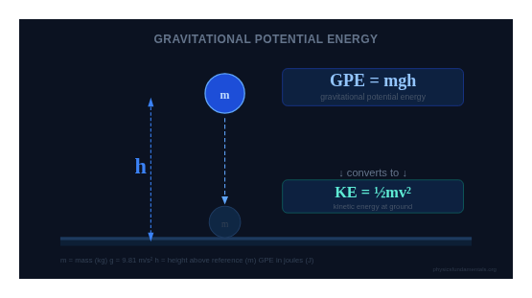




Gravitational Potential Energy
Consider a ball of mass near the Earth's surface.
The gravitational force is .
"Near" means height is very small compared to Earth's radius( ), so is treated as constant.
If we raise the ball to height , the work done by the external agency against gravity is .
This work gets stored as potential energy, denoted as .

Slide 43



Force as a Derivative of Potential
The gravitational potential energy as a function of height is:
If is a variable, the gravitational force equals the negative of the derivative of with respect to :
The negative sign indicates the force of gravity points downward (opposite to the positive upward direction of h).

Slide 44





Proving the Conversion to Kinetic Energy
When released, the ball falls. Just before hitting the ground, its speed is given by the kinematic relation:
Kinematic Equation:
Multiply both sides of this equation by :
Simplify the right side (the 2s cancel):
This proves that the potential energy at height h manifests completely as kinetic energy upon reaching the ground.

Slide 45





Conservative Forces (Mathematical Definition)
The notion of potential energy is only applicable to conservative forces—forces where work done gets stored as energy.
Mathematically in 1D, potential energy is defined if force can be written as:
This implies (by rearranging and integrating):
Or expressed as a change: . The change in potential energy is the negative of the work done by the force.

Slide 46







Deriving Energy Conservation
Suppose a body undergoes displacement under a conservative force .
From the Work-Energy Theorem:
From the definition of Potential Energy:
Because both expressions equal , we equate them:
This proves the sum of kinetic and potential energy is a constant!

Slide 47
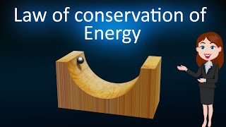

Slide 48

The Conservation of Mechanical Energy
A Step-by-Step Mathematical Analysis

Slide 49


1. What is Mechanical Energy?
The Total Mechanical Energy of a system is the sum of its macroscopic energies associated with motion and position.
Total Mechanical Energy ($E$):
K (Kinetic Energy): Energy of motion.
V (Potential Energy): Stored energy based on position or configuration.

Slide 50

2. The Core Principle
"The total mechanical energy of a system is conserved if the forces doing work on it are conservative."
This means that while Kinetic Energy may transform into Potential Energy (and vice versa), their combined total sum remains exactly the same throughout the object's journey.

Slide 51


3. What is a Conservative Force? (I)
A force is classified as "conservative" if it meets specific mathematical conditions.
Condition 1: Scalar Derivation
A force is conservative if it can be perfectly derived from a scalar potential energy function .

Slide 52

4. What is a Conservative Force? (II)
Condition 2: Path Independence
The work done by a conservative force depends only on the starting point and ending point. It does not matter what path the object took to get there.
(Gravity is a perfect example of this)

Slide 53



5. What is a Conservative Force?
Condition 3: Closed Loop
Because the work depends only on the endpoints, if an object travels in a complete, closed loop (where the start and end positions are exactly the same), the total work done by the conservative force is zero.
If :

Slide 54


6. Mathematical Statement of Conservation
If we track an object from state $i$ (initial) to state $f$ (final), the conservation of mechanical energy is written as:
Or, expressing it in terms of changes ($\Delta$):

Slide 55

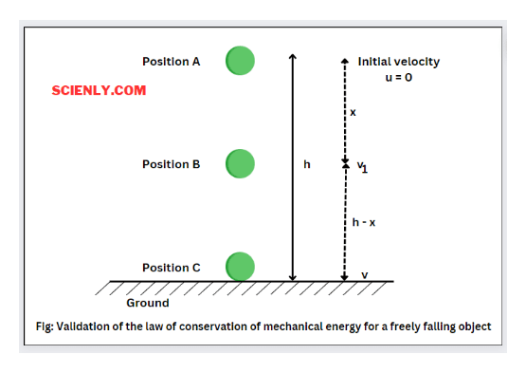
7. Application: A Free-Falling Body
To prove this principle mathematically, let's analyze a classic physics scenario.
A ball of mass is dropped from rest.
It falls from a cliff of total height .
Gravity is the only force acting on it (a conservative force).
Because gravity is conservative, we know Total Mechanical Energy will be perfectly conserved throughout the fall.

Slide 56



8. Analyzing the Three Stages
To verify the conservation, we will calculate the Total Mechanical Energy ( ) at three very specific points during the ball's descent:
1.
At Maximum Height ( ) - The exact moment it is released.
2.
At Ground Level ( ) - The exact moment before impact.
3.
At an Intermediate Height ( ) - Somewhere in the middle of the fall.

Slide 57

9. Stage 1: Maximum Height ($H$) - Potential
Let's calculate the components of energy at the very top of the cliff.
Potential Energy (V):
The ball is at a height relative to the ground.

Slide 58




10. Stage 1: Maximum Height (H) - Kinetic
Kinetic Energy ($K$):
The ball is "dropped from rest". This means its initial velocity ( ) is exactly zero.
Substitute v = 0:

Slide 59



11. Stage 1: Total Energy (E_H)
Now, we sum the components to find the Total Mechanical Energy at height .
Summing K and V:
Conclusion: At the very top, 100% of the object's energy is stored as Potential Energy.

Slide 60


12. Stage 2: Ground Level (0) - Potential
Now, let's analyze the exact moment the ball reaches the ground (height = ).
Potential Energy ($V$):
Because the height is zero, the potential energy formula evaluates to zero.

Slide 61



13. Stage 2: Ground Level (0) - Kinetic
Kinetic Energy (K):
At ground level, the ball has accelerated to its maximum final velocity, which we will call .

Slide 62




14. Stage 2: Total Energy (E_0)
We sum the components to find the Total Mechanical Energy at ground level (height ).
Summing K and V:
Conclusion: At the very bottom, 100% of the object's energy has been converted into Kinetic Energy.

Slide 63



15. Equating Top and Bottom Energies
By the Law of Conservation of Mechanical Energy, the total energy at the top of the cliff MUST exactly equal the total energy at the bottom.
Substitute the equations we just derived:

Slide 64




16. Deriving Final Velocity (I)
Now, let's solve this equation to find the final velocity ( ).
Starting Equation:
Notice that mass appears on both sides. Divide both sides by to cancel it out.
Cancel mass:

Slide 65




17. Deriving Final Velocity (II)
Next, isolate the velocity term.
Current Equation:
Multiply both sides of the equation by to clear the fraction.
Multiply by 2:

Slide 66




18. Deriving Final Velocity (III)
Finally, solve for .
Current Equation:
Take the square root of both sides.
Final Result:
(Notice that final velocity is completely independent of mass!)

Slide 67



19. Stage 3: Intermediate Height (h)
What about a point in the middle of the fall? Let's look at an intermediate height (where ).
Potential Energy ($V$): The ball still has some height, so .
Kinetic Energy ($K$): The ball is falling with some intermediate velocity , so .
At height H, energy is actively converting. It is a mix of both potential and kinetic energy.

Slide 68



20. Stage 3: Total Energy ($E_h$)
We sum the components to find the Total Mechanical Energy at intermediate height .
Summing K and V:

Slide 69


21. Equating Top and Intermediate Energies
Because energy is strictly conserved, the total energy at the top ($E_H$) must equal the total energy at height
Substitute the equations we derived:

Slide 70



22. Deriving Intermediate Velocity (I)
Let's solve for the intermediate velocity ( ).
Starting Equation:
Mass ( ) is in every single term. Divide the entire equation by to cancel it out.
Cancel mass:

Slide 71


23. Deriving Intermediate Velocity (II)
We need to isolate the kinetic term containing .
Current Equation:
Subtract from both sides of the equation.
Group gravity terms:

Slide 72


24. Deriving Intermediate Velocity (III)
Factor the left side and clear the fraction on the right.
Factor out gravity ():
Multiply both sides by to completely isolate the velocity term.
Final Result:

Slide 73
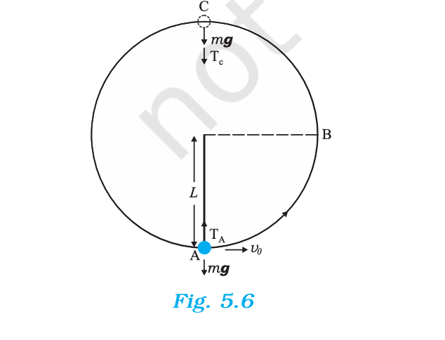
Example 5.7: Vertical Pendulum
Problem Setup
Bob of mass m suspended by string length L. Imparted horizontal velocity v0 at lowest point A. String slackens at highest point C.
Point A: Lowest
Point B: Middle
Point C: Highest

Slide 74







Example 5.7: Calculations
(i) Finding v0
(ii & iii) Speeds and Ratios

Slide 75
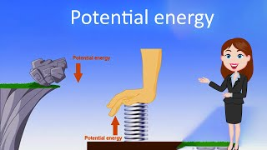
5.1 Spring Potential Energy & Hooke's Law
Equilibrium Position
For an ideal spring, Hooke's Law states Fs = -kx, where k is the spring constant.
When the block is at the equilibrium position (x = 0), the spring force Fs is exactly 0.

Slide 76
The Potential Energy of a Spring
Hooke's Law, Work Integration, and Energy Conservation

Slide 77
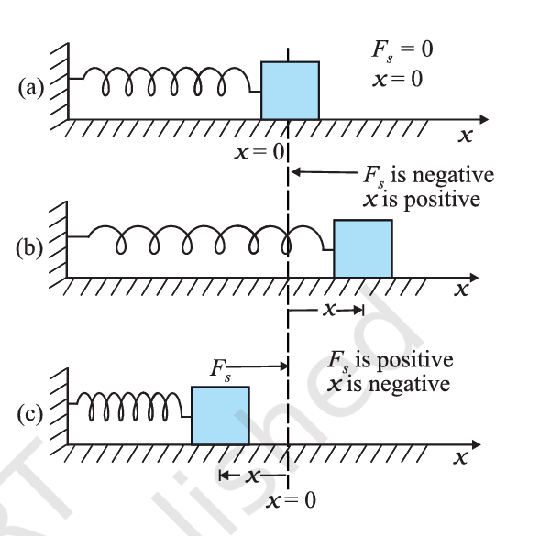

The Spring System
The System: A block attached to one end of a light (massless) spring resting on a smooth horizontal surface. The other end is attached to a rigid wall.
Equilibrium: When the block is at rest and the spring is neither stretched nor compressed, it sits at its equilibrium position ( ).
Variable Force: Unlike gravity near the Earth's surface, the force a spring exerts changes depending on its displacement. It is a conservative, variable force.

Slide 78




Hooke's Law
The relationship between the spring's restoring force ( ) and its displacement ( ) from equilibrium is defined by Hooke's Law.
Mathematical Statement:
The constant is the spring constant (Units: N m⁻¹).
The negative sign indicates that the force always acts in the opposite direction to the displacement (it's a restoring force).

Slide 79






Work Done: Stretching from Equilibrium
Let's calculate the work done by the spring force ( ) if the block is pulled outwards to a maximum extension .
Because the force varies with distance, we must integrate the force function over the displacement from to . :
Setup the Integral:
Substitute Hooke's Law ( ):

Slide 80







Work Done: Integration Steps
Pull the constants (-k) outside the integral:
Apply the power rule for integration ( ):
Evaluate at the limits:

Slide 81




Work Done: Final Expression
Simplifying the evaluated integral gives us the final expression for the work done by the spring force.
Final Equation (5.15):
Note: The work done by the spring is negative because the spring pulls backwards while the displacement is forwards. Conversely, the work done by the external pulling force must be positive ( ) as it overcomes the spring force.

Slide 82

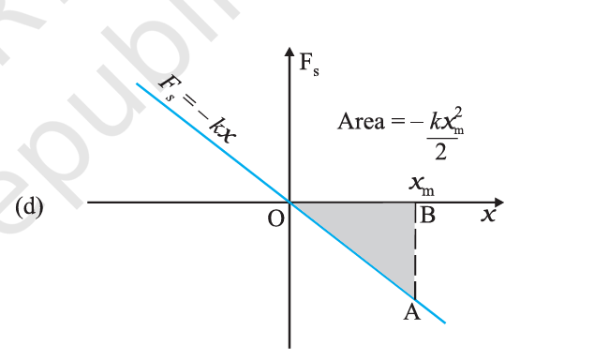



Graphical Method: Area Under the Curve
The work done can also be found by calculating the area under the Force vs. Displacement graph.
The plot of is a straight line passing through the origin with a negative slope.
The area under this curve between and forms a triangle.
Area of a triangle =
Area =

Slide 83





Work Done Between Arbitrary Positions
If the block moves from an initial displacement a final displacement , we adjust our integration limits.
Integrate from initial to final position:
Evaluate the integral:

Slide 84




Proving the Spring Force is Conservative
A force is strictly defined as conservative if the work it does in a cyclic process (a closed loop) is zero.
Suppose the block is pulled from and then allowed to return exactly to . Here, the initial and final positions are identical ( ).
Substitute identical limits into the work equation:
Equation 5.18:
Because the work done depends only on endpoints and the work in a closed path is zero, we explicitly demonstrate that the spring force is a conservative force.

Slide 85


Defining Potential Energy
Because the spring force is conservative, we can define a potential energy function for it.
We establish the baseline by defining the potential energy to be zero when the block and spring system is at the equilibrium position ( ).
Potential Energy for extension/compression (Equation 5.19):

Slide 86





Conservation of Mechanical Energy
If the block is extended to and released from rest, its total mechanical energy is conserved at any arbitrary point (where ).
Total Energy at initial state ( ):
Total Energy at arbitrary state ( :
Equating the two states:

Slide 87




Deriving Maximum Speed
The conservation equation suggests that kinetic energy (and thus speed) will be maximum when potential energy is minimum. This occurs exactly at the equilibrium position ( ).
Start with the conservation equation:
Substitute and :

Slide 88




Solving for Maximum Speed ( )
Now we solve algebraically for .
Multiply both sides by 2:
Divide by mass ( ):

Slide 89
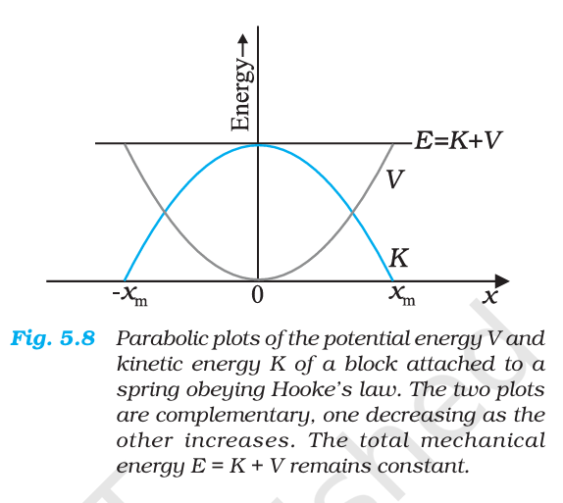

Graphical Representation of Energy
The plots for potential energy and kinetic energy are both parabolic.
These two curves are completely complementary. As the block moves towards equilibrium, decreases while increases perfectly proportionally.
Because energy is conserved, the sum of these two curves at any displacement always equals a constant value.
This creates a straight horizontal line representing the Total Mechanical Energy

Slide 90


Example 5.8: Car collides with spring
Problem Setup
Maximum Compression
Car mass 1000 kg, moving at 18 km/h collides with spring k = 5.25 × 10³ N/m. No friction.

Slide 91


Slide 92

Modified Energy Conservation
Non-Conservative Forces
Mathematical Adjustment
When non-conservative forces (Fnc) like friction exist, energy is not perfectly conserved; it changes.

Slide 93

Understanding Power

Slide 94



Defining Power
Definition: Power is defined as the rate of doing work.
Average Power Formula:
Where:
W = Total Work
t = Total Time

Slide 95




Instantaneous Power
For instantaneous power, we look at an infinitesimally small amount of work done over an infinitesimally small time interval.
Starting with the derivative:
Since work is Force multiplied by displacement ( ), we substitute:

Slide 96



Instantaneous Power & Velocity
We know from kinematics that velocity is the rate of change of displacement ( ).
Applying this to our previous equation:
Final Instantaneous Power Equation:
Where v is the instantaneous velocity when the force is F.

Slide 97




Units and Dimensions
SI Unit
Dimension
watt (W)
or
J s⁻¹ (Joules per second)
Another common unit of power:
1 HP = 746 W
(Horsepower)

Slide 98


Practical Application: Electricity
We often encounter the unit 'watt' when we buy electrical goods, such as light bulbs.
Example Scenario:
You have a 100 watt bulb.
It is turned on for 10 hours.
This usage is calculated in kilowatt hours (kWh).

Slide 99
Calculating Energy Usage
PRACTICAL
1. Kilowatt-Hour (kWh)
2. Conversion to Joules
Let's calculate the total energy used by a 100-watt bulb running for 10 hours:
Converting this to Joules, which is the standard SI unit of energy:
Energy = 100 W × 10 h
= 1000 Wh
= 1 kilowatt hour (kWh)
1 kWh = 10³ W × 3600 s
= 3.6 × 10⁶ J
= 3.6 MJ

Slide 100

Example 5.10: Elevator Power
Problem Setup
Calculation
Elevator load = 1800 kg, moving up with speed 2 m/s. Frictional force = 4000 N.

Slide 101

7.1 Collisions: Basic Principles
Universal Principle
Proof via Newton's Third Law
Linear momentum is always conserved in all collisions.

Slide 102
Types of Collisions
Type | Momentum Conserved? | Kinetic Energy Conserved? | Deformation
Elastic | Yes | Yes | Fully recovered
Inelastic | Yes | No | Partly recovered
Perfectly Inelastic | Yes | No (max loss) | Not recovered

Slide 103

1D Elastic Collisions
Complete Step-by-Step Mathematical Derivation

Slide 104
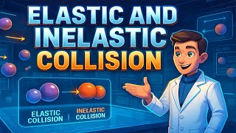



The Initial Setup
An elastic collision means two quantities are perfectly conserved:
Total Momentum
Total Kinetic Energy
Initial Condition for this derivation:
We assume Object 2 is initially at rest.

Slide 105



Step 1: The Conservation Equations
Because $\$v_\{2i\} = 0\$,$our starting equations drop the initial term for mass 2.
Equation 1: Conservation of Momentum
Equation 2: Conservation of Kinetic Energy (1/2 terms cancelled)

Slide 106





Step 2: Grouping the Masses
Rearrange both equations to group terms on the left and terms on the right.
Rearranging Eq 1 (Momentum):
Rearranging Eq 2 (Energy):
Factor out m₁:
Factor out m₁:
(Equation A)

Slide 107


Step 3: Factoring the Energy Equation
Take the rearranged Energy equation and expand the difference of squares:
Rearranged Energy Equation:
Applying difference of squares:
(Equation B)

Slide 108


Step 4: Dividing the Equations
Divide the factored Energy equation (Eq B) by the Momentum equation (Eq A).
Equation B divided by Equation A:
Cancel common terms from numerator and denominator:

Slide 109

Step 5: Solving for v₁f (Substitution)
Substitute back into the original Momentum equation (Eq 1).
Original Momentum Equation:
Substitute v₂f:
Expand the m₂ term:

Slide 110


Step 6: Finalizing v₁f
Group the terms on the left, and the terms on the right.
Group terms:
Factor out the velocities:
Divide to isolate v₁f:

Slide 111




Step 7: Solving for v₂f (Substitution)
Substitute our new equation for back into .
Substitute into velocity relation:
Factor out v₁i:
Create a common denominator for the '1':

Slide 112




Step 8: Finalizing v₂f
Combine the numerators over the common denominator and simplify.
Combine numerators:
The +m₂ and -m₂ cancel out:
Rearrange to standard form:

Slide 113




Case I: Equal Masses (m₁ = m₂ = m)
Substitute for both masses into our final equations.
Result: Velocities swap perfectly. The moving object stops, and the stationary object takes all the velocity.

Slide 114



Case II: Dominant Mass (m₂ ≫ m₁)
Because m₁ is negligibly small compared to m₂, we can approximate:
Result:
The tiny object ricochets backward with its initial speed.
The massive object remains entirely undisturbed.

Slide 115



Example 5.11: Neutron Moderation
Problem Setup
Energy Fractions
Neutron slows down in a reactor.
Deuterium (m2 = 2m1): f1 = 1/9, f2 = 8/9.
FRACTION RETAINED
Carbon: f1 = 71.6%, f2 = 28.4%.
FRACTION TRANSFERRED

Slide 116


Slide 117
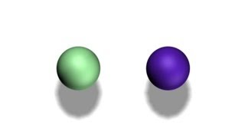

7.3 Collisions in Two Dimensions
Momentum Components

Slide 118



Example 5.12: Elastic 2D Billiards
Proof Concept
Calculation
When two equal masses undergo a glancing elastic collision (one at rest), they always move at right angles.

Slide 119
Complete Formula Reference
Concept | Mathematical Formula
Work | W = F · d = Fd cos θ
Kinetic Energy | K = ½mv² = p² / 2m
Potential Energy | V = mgh | V = ½kx² | F(x) = -dV/dx
Work-Energy | W_total = ΔK | Ef - Ei = W_nc
Power | P = dW/dt = F · v

